Slide 1
Perioperative Management of Buprenorphine
Tim Furnish, MD
Clinical Professor
UC San Diego Health
August 2023

Slide 2
Disclosures
Fellowship Educational Grants:
Medtronic, Abbott, Boston Scientific, Nevro

Slide 3
Buprenorphine
Buprenorphine
FDA Indications, uses, and legal distinctions
Pharmacokinetics & pharmacodynamics
Experimental and Clinical Evidence for Perioperative Analgesic Interference
Perioperative Recommendations

Slide 4
Medication for Opioid Use Disorder- MOUD
MOUD: Much more effective at relapse prevention than detox
Methadone
Buprenorphine
Legal:
Methadone for OUD: only Rx at a licensed methadone clinic
Buprenorphine for OUD: Anyone with a DEA license. No longer requires X-waiver

Slide 5
Buprenorphine Formulations
Formulations OUD | Available Dosing | Bioavailable | Formulations Pain | Available Dosing | Bioavailable
Buprenorphine SL Tablet (Subutex) | 2mg 8mg | 30% +/- 10% | Butrans Patch Buprenorphine transdermal. | 5 mcg/hr, 7.5 mcg/mr, 10 mcg/hr, 15 mcg/hr, 20 mcg/hr | !5% (bioavailability of total drug inside the patch NOT the listed mcg/hr)
Buprenorphine/naloxone SL tablet | 2mg/0.5mg, 4mg/1mg, 8mg/2mg | 30% +/- 10% | Belbuca buprenorphine buccal | 75 mcg – 900 mcg BID 30-80mg/d OME = start 150mcg BID 90-160mg/d OME = start 300mcg BID | 45-65%
Suboxone buprenorphine/naloxone SL film | 2mg/0.5mg, 4mg/1mg, 8mg/2mg, 12mg/3mg | 30% +/- 10% | Buprenorphine IV (Bupranex) | 0.3mg/ml 0.3mg IM/IV q6-8 hours | 100%
Bunavail buprenorphine/naloxone buccal film | 2.1mg/0.3mg, 4.2/0.7mg, 6.3mg/1mg | 57%
Zubsolv buprenorphine/naloxone SL tablet | 1.4mg/0.36mg, 5.7mg/1.4mg | 42%
Sublocade depot SC Inj prolonged activity buprenorphine | 100mg/5ml 100-300mg SC q month | --
Notes:
Naloxone sublingual present only as abuse deterrent agent. Not well absorbed
The buprenorphine for pain products (patch and Belbuca films) are FAR lower doses than typical Suboxone for OUD and will NOT block the effect of other opioids.

Slide 6
Buprenorphine Pharmacokinetics/Pharmacodynamics
Highly lipophilic
Plasma half-life 4-5 hrs
Extensive 1st Pass Metabolism; liver metabolism by CYP3A4 to active metabolite
Partial agonist at MOR with slow dissociation (prolonged effect) and low efficacy (ceiling effect on ORAE)
High dose Bup + MOR full agonists: Bup competitively inhibits MOR agonists
High binding affinity at MOR
High potency: 20-50x morphine

Slide 7
Binding Affinity and Partition Coefficient
Opioid | Binding affinity (Ki value, nM) | Partition Coefficient (Log P)
Sufentanil | 0.1380 | 3.95
Buprenorphine | 0.2157 | 4.98
Naltrexone | 0.1-1
Hydromorphone | 0.3654 | 1.84
Oxymorphone | 0.4055 | 0.83
Morphine | 1.168 | 0.76
Fentanyl | 1.346 | 4.05
Naloxone | 1.518
Oxycodone | 25.87 | 0.82
Hydrocodone | 41.53
Tramadol | 12,468
Ki: equilibrium dissociation constant, aka binding affinity
Low Ki = High receptor binding affinity
Binding affinity does not equal potency or receptor activity
Partition Coefficient: degree of hydrophilicity
High Partition Coefficient = more lipophilic and cross into CNS more readily
Volpe DA et al. Regulatory Tox & Pharm. 59(2011):385-390
Leighton B, Crock L. Anesthesia & Analgesia125(5):1779-1783, November 2017.
Notes:
aLog P corresponds to the logarithm of the ratio of the concentrations of the studied compound in octanol and in water: LogP = Log (Coct/Cwater).
The partition coefficient refers to the concentration ratio of un-ionized compound (distribution coefficient refers to the concentration ratio of all species of the compound (ionized plus un-ionized).
Most commonly, one of the solvents is water, and the second is hydrophobic, such as 1-octanol.[3] The partition coefficient measures how hydrophilic or hydrophobic a chemical substance is. Partition coefficients are useful in estimating the distribution of drugs within the body. Hydrophobic drugs with high octanol-water partition coefficients are mainly distributed to hydrophobic areas such as lipid bilayers of cells. Conversely, hydrophilic drugs (low octanol/water partition coefficients) are found primarily in aqueous regions such as blood serum.
A drug's distribution coefficient strongly affects how easily the drug can reach its intended target in the body, how strong an effect it will have once it reaches its target, and how long it will remain in the body in an active form.

Slide 8
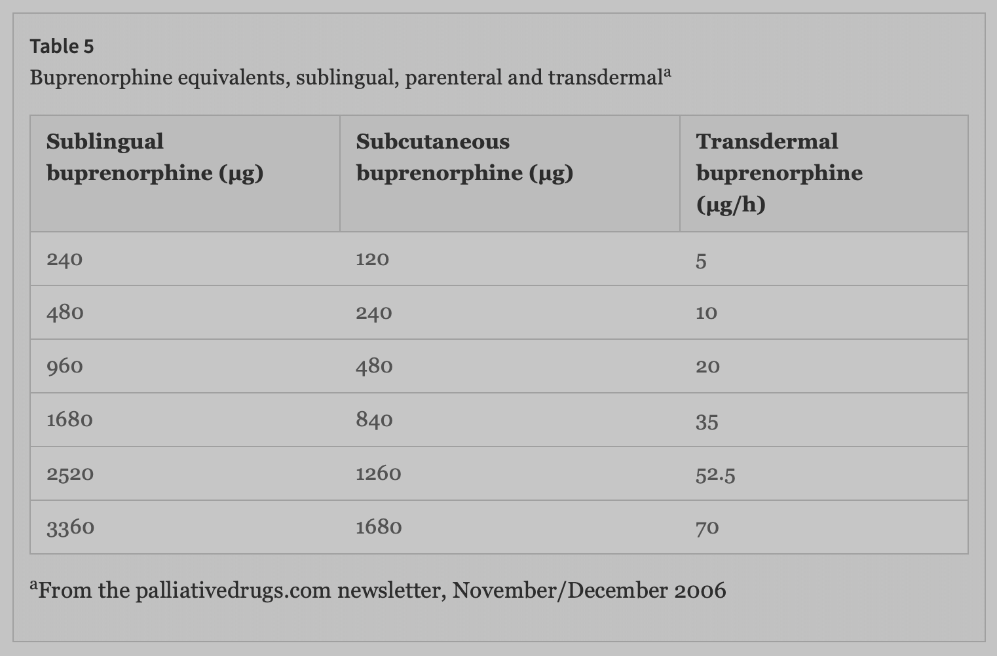
Buprenorphine Morphine Equivalence
IV Buprenorphine: SL Buprenorphine 1:2-3
IV Buprenorphine: IV Morphine 1:30-40
SL Buprenorphine: Oral Morphine 1:80
TD Buprenorphine: Oral Morphine 1:100
24 mg/day SL buprenorphine = 1900 OME!!
20 mcg buprenorphine Patch = 48 OME = .96 mg SL bup
https://www.palliativedrugs.com/download/BUPRENORPHINE021206.pdf
Notes:
Using 1:80 a 24mg/d suboxone = 1900 OME
Using grey table 20mcg patch = 48 OME = 960 SL bup
If it were 24mg SL bup that would be 1200 OME

Slide 9
Buprenorphine Perioperative
Issues:
High dose Bup may antagonize analgesia of other opioid agonists
Stopping Bup preop may cause withdrawal & increases risk of relapse
Evidence that high dose Bup is either compatible/incompatible with post-op analgesia – limited
If Bup stopped – risk of precipitated withdrawal post-op if restarted when on full agonists

Slide 10
Buprenorphine
Study: 10 heroin dependent volunteers on 16 mg/day buprenorphine
Mu receptor availability and hydromorphone agonist effects at 4, 28, 52 and 76 hrs after last Bup dose
Hydromorphone 24mg IM given DBPC at each time point
4 & 28 hrs: hydromorphone agonist symptoms and CO2 sensitivity blocked
52 & 76 hrs: hydromorphone agonist symptoms present and CO2 sensitivity reduced
Threshold for agonist symptom suppression and withdrawal suppression:
Around 40-50% of mu-receptor availability
Greenwald et al. Buprenorphine Duration of Action: Mu-opioid Receptor Availability and Pharmacokinetic and Behavioral Indices. Biol Psychiatry, 2007
Notes:
DBPC dose omission study with hydromorphone IV challenge and assessment of withdrawal sx administered hydromorphone IM @ 1 hr intervals dose of 0, 6, 6, 12 mg
Unclear if agonist sx suppression is same as analgesia suppression

Slide 11
Buprenorphine
Mu-receptor availability based on buprenorphine dose. Whole brain mu-receptor availability
2mg: reduced 41%
16mg: reduced 85-92%
32mg: reduced 94-98%
Greenwald et al. Neuropsychopharmacology (2003) 28, 2000–2009
Notes:
Different Study: 5 bup maintained heroin addicts on 32mg 16mg 2mg and 0 mg bup

Slide 12
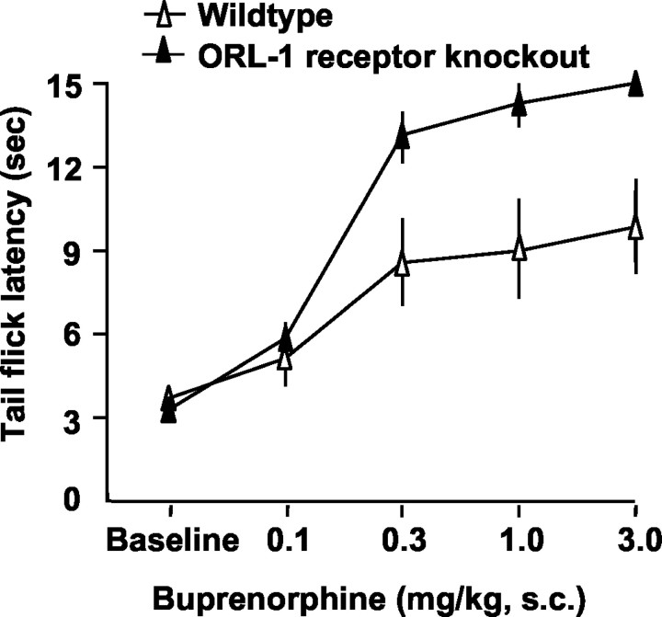
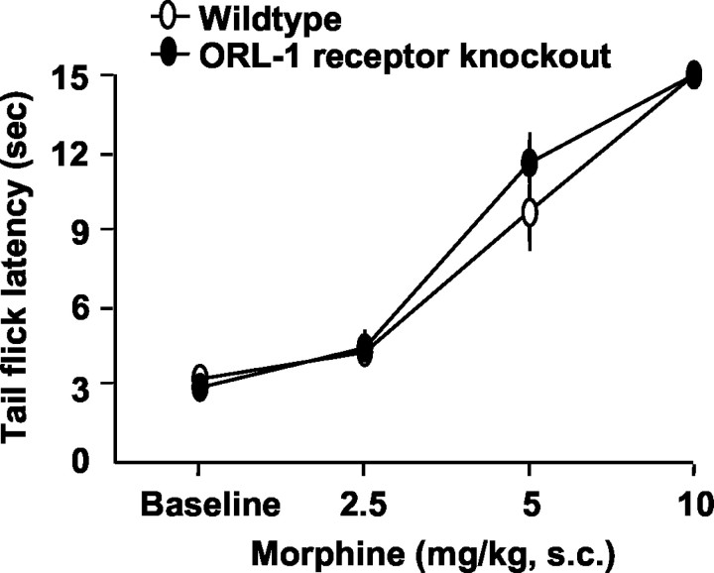
Analgesia: Buprenorphine vs Morphine (Tail Flick)
Lutfy et al. J Neurosci. 2003 Nov 12; 23(32): 10331–10337
Notes:
As dose increases Morphine analgesia increases. As dose increases buprenorphine analgesia plateaus
Tail flick test dose response curve
ORL-1 receptor activation hypothesized to block analgesia and Bup activates ORL-1 receptors. ORL-1 knockout mice had greater analgesia with Bup but not with morphine

Slide 13
Buprenorphine & Analgesia
Tail Flick Test Rat Model
Low Dose Bup + full agonists (morphine, oxycodone, fentanyl, hydromorphone) given in analgesic dose ranges: additive or synergistic analgesia
High Dose Bup: Moderate antagonistic effect of Bup on full agonist
7-8 hours after Bup: Full analgesic effects of full agonists
Kogel et al. Eur J Pain. 2005 Oct;9(5):599-611

Slide 14
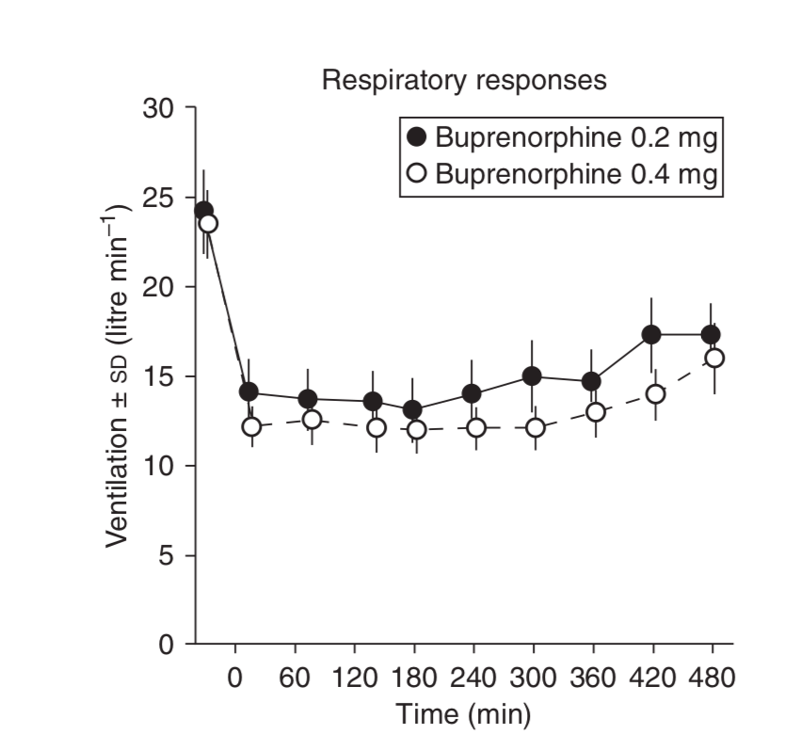
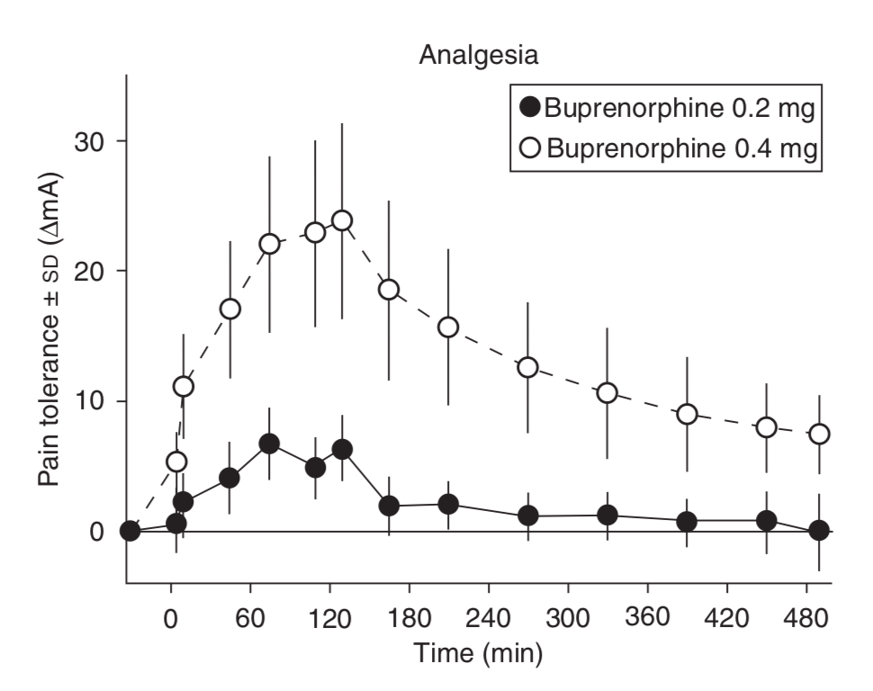
Buprenorphine Ceiling Effect?
Dahan et al. Br J Anaesth. 2006; 96(5):627–32
Notes:
10 healthy volunteers, experimental pain stimulus
No difference between doses on respiratory depression
More analgesia at higher dose
Only gave 2 doses IV. Assuming 30% bioavailability of Suboxone the 0.4mg dose is equivalent to 1.3mg of Suboxone

Slide 15
Evidence: Buprenorphine Perioperative
Khelemsky (2015) Case Report
Emergent C-spine Surgery
Surgery 1 TIVA (prop/remi no NMBD) movement uncontrolled until addition ketamine
Bup d/c post-op
POD 5 underwent Surgery 2; significantly reduced anesthetic requirements
Huang (2014) Case report
Clagett window closure on 16mg bup
Poor pain control until bup weaned
McCormick (2013) Case report
Acute thigh pain/fasciotomies; on buprenorphine/naloxone
Higher than expected opioid dose required
Harrington (2010) Case report
30 yo MVA polytrauma
Poor pain control until Bup d/c
Book (2007): Case report
Breast implant removal; on 24mg/d bup
As outpatient given supplemental bup up to 12mg q6 hrs in addition to baseline dose
Good pain control
Kornfeld (2010) Case series: 5
On bup for pain (?) >1 yr
Opioids, bupivacaine +/- ketamine generally good pain control
Quaye (2020): Retrospective Cohort: N 55
Mod dose bup: 15-17 mg/d
38 continued vs 17 held
Holding bup = increased opioid use post-op and higher PACU pain scores
Notes:
Left Column: case reports of buprenorphine interfering
Right Column: case report of using extra bup successfully and case series of good pain control

Slide 16
Buprenorphine Periop Obstetrics
Bup vs Methadone Cesarean
Retrospective Cohort
185 methadone (mean dose 93.7mg) vs 88 Bup (mean dose 16.1mg)
No significant difference in MED post-op between the two groups
Bup vs Opioid Naïve Vaginal/Cesarean
Retrospective Case/Control
63 Bup patients (44 vaginal, 19 cesarean)
Mean Bup dose 13.7mg (SD 6.2)
No diff: pain at admission, time to delivery, % choosing neuraxial analg, or intrapartum IV opioid
Postpartum: PS higher in Bup pts both vaginal & Cesarean; opioid use higher cesarean not vaginal
Vilkins et al. Journal of Addiction Medicine: September/October 2017.(11)5:397-401
Meyer M et al. Eur J Pain. 2010;14(9):939-943
Notes:
Study 1: bup was not worse than methadone – just opioid tolerance perhaps??
Study 2: Bup patients vs opioid naïve – higher PS cesarian no diff vaginal (mean bup dose wasn’t super high)

Slide 17
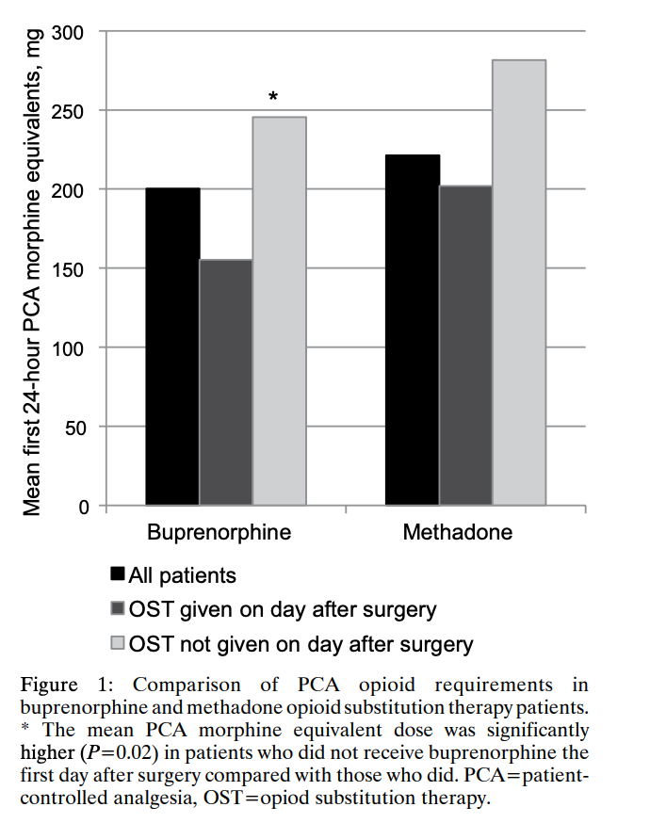
Buprenorphine Perioperative
Retrospective Cohort
N=51; 29 methadone, 22 bup
Compared 1st 24 hr post-op opioid use when bup/methadone held POD 0 vs given POD 0
More opioid used when held
Mean Bup dose 13.7mg/d (SD 6.6); range 4-32mg/d
Holding POD 0 increases opioid requirement
Macintyre PE et al. Anaesth Intensive Care 2013
Notes:
Holding Bup/Methadone on DOS vs giving on DOS – don’t hold it
Graph is OME in the first 24 hrs

Slide 18
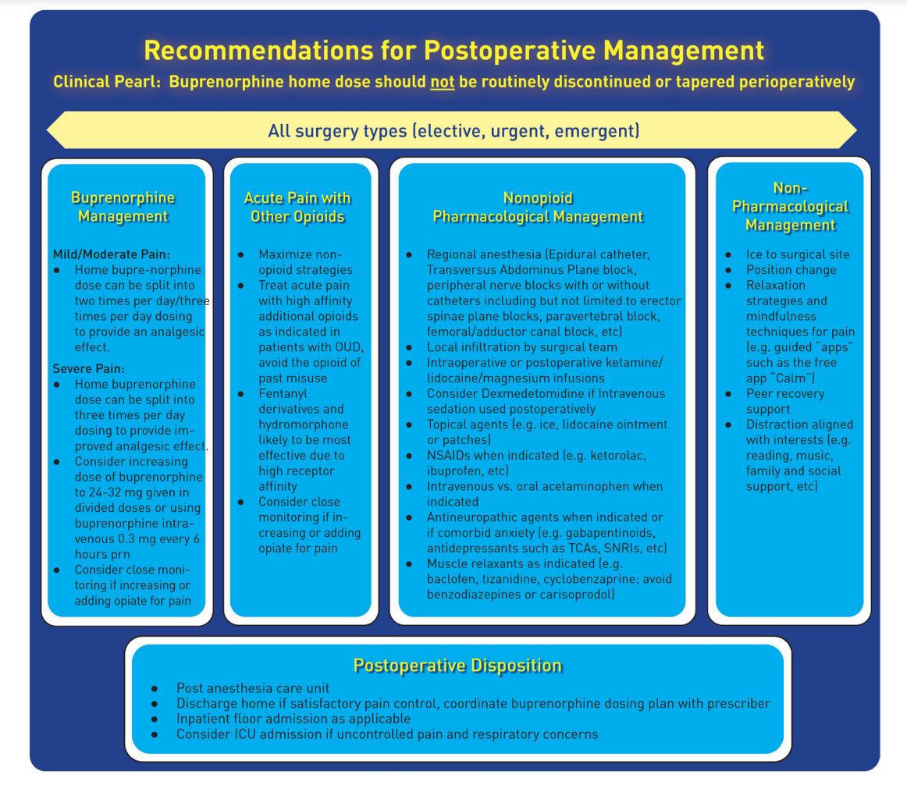
Buprenorphine Perioperative
Multispecialty society work group review article; RAPM 2021:
Recommend NO Bup dose adjustment
Continue Bup periop divided BID-TID
Add regional/ ketamine/ lidocaine/ nsaid/ apap/ gabap/ topicals
Kohan L, et al. Reg Anesth Pain Med 2021;46:840–859
Notes:
Recent review article in RAPM: recommended NO DOSE CHANGE, just divide TID postop

Slide 19
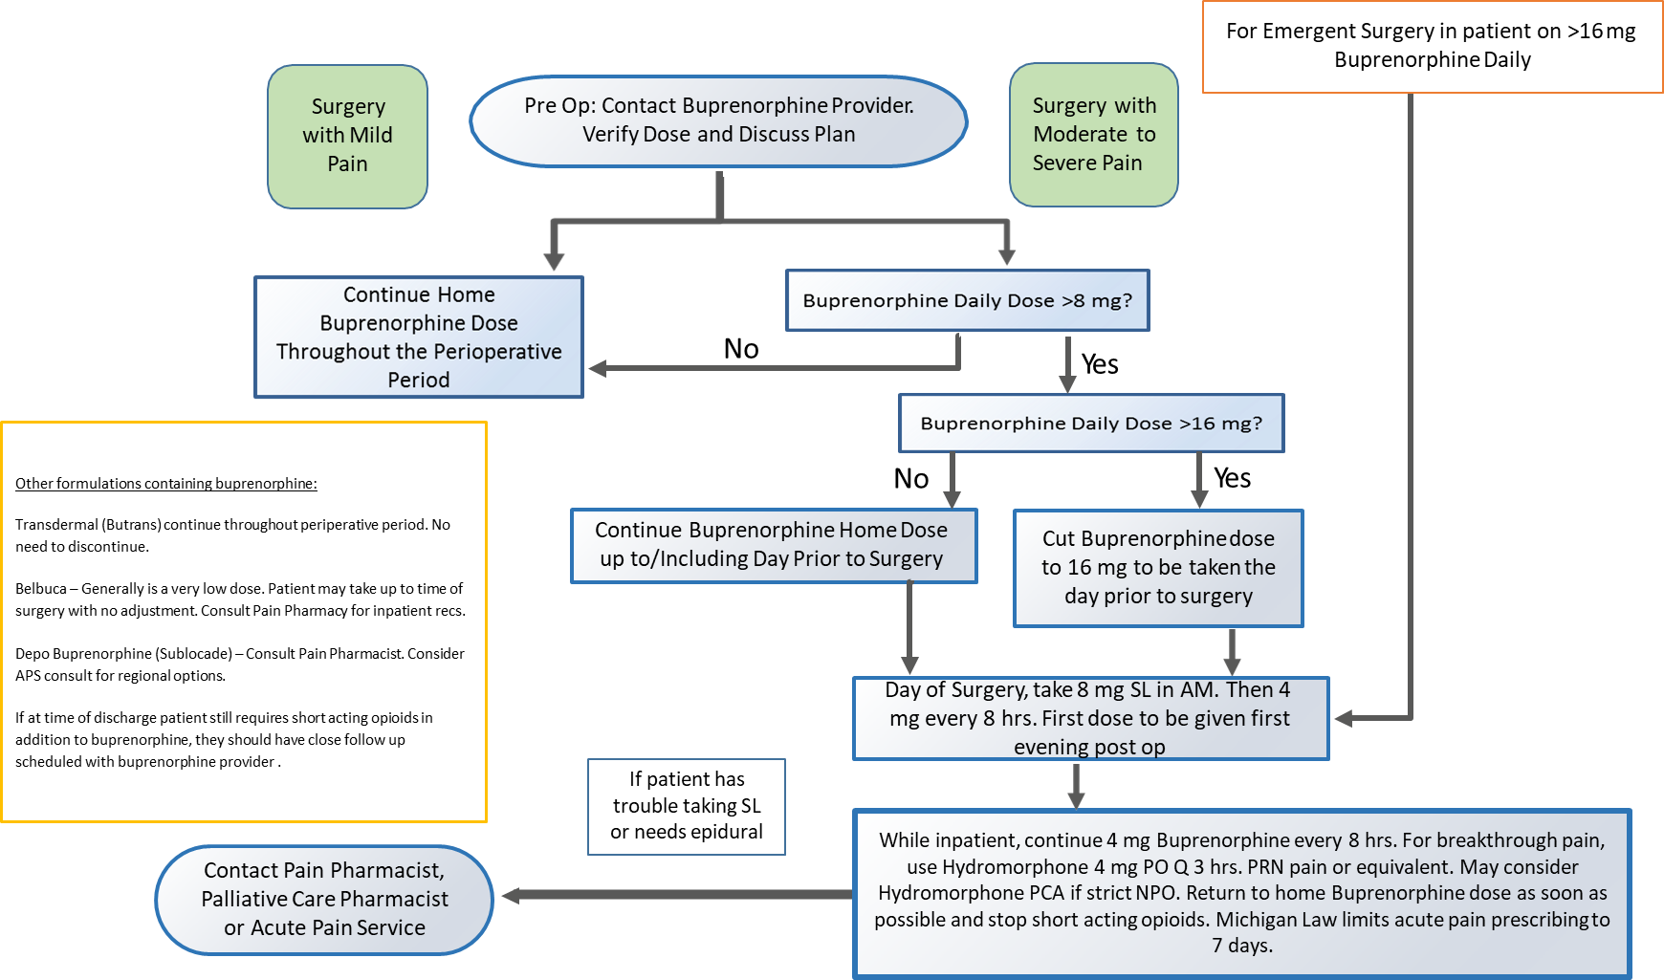
University of Michigan Buprenorphine Periop Protocol
Notes:
From Michigan Open

Slide 20
Key Points of Protocol
Continue buprenorphine regardless of indication (opioid use disorder or chronic pain)
For high daily dose buprenorphine (16mg or higher), consider weaning to lower dose on the day of surgery
Consult acute pain service and/or pain pharmacist
Use multimodal analgesia and regional anesthesia as appropriate
No changes to dosing recommended for low-dose buprenorphine
Subcutaneous depo formulations will not allow for dose changes
Notes:
University of Michigan

Slide 21
MGH Buprenorphine Periop Protocol
Acampora GA, Nisavic M, Zhang Y. Perioperative buprenorphine continuous maintenance and administration simultaneous with full opioid agonist: patient priority at the interface between medical disciplines. J Clin Psychiatry. 2020;81(1):19com12810.
Notes:
Differences from U Michigan: MGH cut to 16mg day before surgery, 8mg day of surgery then 4mg BID inpatient after surgery vs Umichg cut to 16 day before and then 8mg morning of surgery, then 4mg TID after

Slide 22
UCSD Elective Surgery Protocol
Elective Surgery
Low Pain Surgery?
High Pain Surgery?
No
> 8 mg/day buprenorphine?
Continue Buprenorphine Dose Unchanged
Yes
8-12 mg/day: No change before surgery, split daily dose q8 –q12 hrs post-op.
>12 mg/day buprenorphine?
> 12 mg/day buprenorphine for OUD?
> 12 mg/day buprenorphine for Chronic Pain?
Discuss these potential changes with Bup provider first then consider:
Decrease to 16 mg on the day before surgery
Day of surgery and during hospital stay give 4mg q8 hours
Decrease to 16 mg on the day before surgery
Day of surgery and during hospital stay give 4mg q8 hours

Slide 23
Thank You

